Slide 1
Continuous Delivery
Mark Henke, Ryder Logistics
@gilligan128
gilligan128@gmail.com
Penguicon, April 2015

Slide 2
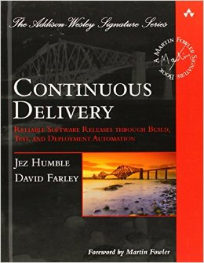
Background

Slide 3
Agile Team
Development is Agile but it stops after the code.
Notes:
Throw things over the QA wall

Slide 4
Releasing Frequently
Faster Feedback
Lower Risk
Real Project Progress
Notes:
A slide per section

Slide 5
Faster Feedback

Slide 6
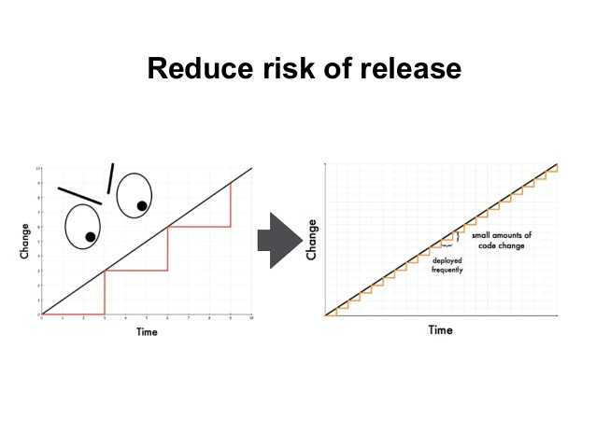
Reduce Risk
Notes:
Incremental fashion. Strangler Pattern.

Slide 7
Real Project Progress
“Show me the Software!”
Notes:
Use Software voer metrics, or have metrics be based off of real value.

Slide 8
Production-Ready Software
Fast, automated feedback every time there is a change. code, db. etc.
Includes configuration and Infrastructure changes

Slide 9
Continuous Delivery
Software always production-ready
Releases tied to business needs, not operational constraints.
You know you are deploying fast enough when the business asks you to slow down.

Slide 10
Product Teams
Cross-functional teams
Teams by Product, not Project
No centralized technical roles (QA, DBA etc)
Will require org changes

Slide 11
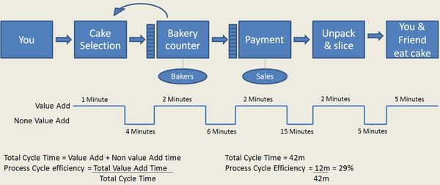
Value Stream Mapping

Slide 12
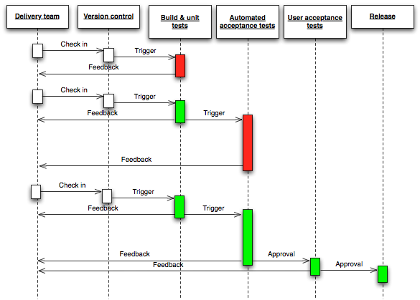
Deployment Pipeline
Notes:
Every Check-in (like Continuous Integration)
Automated system for deployment
Tries to prove your software is not production ready

Slide 13
Deployment Pipeline Characteristics
Commit Stage. Build, package. Machines aren’t production-like
Later stages, Acceptance, performance and UA Testing, need to be as much like production as possible.
AUtomated testing is essential.
Infrastructure automated.

Slide 14
Principles
Create a repeatable, reliable build for releasing software. (Should be push-button)
Automate almost everything.
If it hurts do it more often, and bring the pain forward
Keep everything in version control. Including config and infrastructure.
Done means released
Build quality in.
Everybody is responsible for delivery
Continuous Improvement..

Slide 15
Ask the question
“How long would it take to your organization to deploy a change that involved just one single line of code? Do you do this on a repeatable, reliable basis?” - Mary and Tom Poppendieck, Implementing Lean Software Development, p59
What obstacles are there to getting software out the door?

Slide 16
Practices
Only build your binaries once
Deploy the same way to every environment
Smoke test your deployments
Keep your environments similar. Every difference is a chance for error.
If anything fails, stop the line.
Notes:
Separate out config info

Slide 17
Continuous Integration
Everybody checks into main branch. x (more often than you think)
Use branch by abstraction for architectural changes
use feature toggles to switch off incomplete features
Notes:
do you checkin less than once a day? Do you have branches that last more than a couple days?

Slide 18
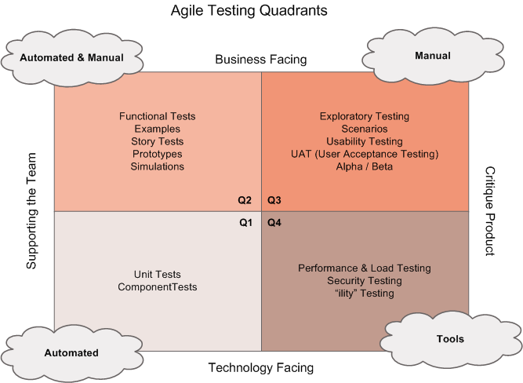
Testing
From Brian Marick
Notes:
By Brian Marick

Slide 19
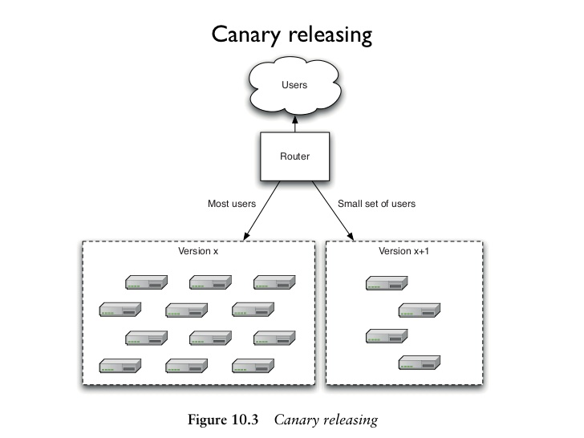
Canary Releasing

Slide 20
Database Migration
Script Manager
Expand/Contract
Abstract Data Access

Slide 21
Objections
Visibility and control over locking down
Compliance - automation over documentation
Auditing - see who does what
Make it easy to fix outages

Slide 22
Tools
Octopus Deploy
TeamCity
Thoughtworks Go
Jenkins
Travis CI
Powershell & DSC
Chef
Puppet

Slide 23
Organizational Change
This is a mindset, a culture.
You have to change it little by little
Notes:
Frog and boiling water

Slide 24
Questions?
@gilligan128
gilligan128@gmail.com
http://www.amazon.com/Continuous-Delivery-Deployment-Automation-Addison-Wesley/dp/0321601912

